Slide 1

DISEASE PREDICTION SYSTEM USING SYMPTOMS IN PYTHON
BONAM VENKATA CHALAMAYYA INSTITUTE OF TECHNOLOGY AND SCIENCE
DEPARTMENT OF COMPUTER SCIENCE AND ENGINEERING
UNDER THE GUIDANCE OF:
Mr. K.Nagendra Babu, M.Tech
Associate professor
PRESENTED BY:
N. Mounika - 20H41A0597
A. Jashwanthi - 20H41A0569
N. Jhansi - 20H41A0598
K. V. S. D. V. Varma - 20H41A0585
V. Charan Sri Sai Teja - 20H41A05C5

Slide 2
CONTENTS :
Abstract
Introduction
Literature Survey
Existing system
Proposed system
Functional & Non functional Requirements
System Specifications
System Architecture
UML Diagrams
Implementation
Testing
Test Cases
Output Screens
Conclusion
References

Slide 3
ABSTRACT :
The proposed system aims to develop a robust and scalable framework for disease prediction using symptoms in Python. Leveraging machine learning algorithms and symptom data, the system will provide accurate predictions of disease onset, facilitating early detection and personalized intervention. Key components include data collection, preprocessing, feature engineering, model development, real-time monitoring, user interface design, validation, and ethical considerations. By harnessing Python's capabilities and interdisciplinary collaboration, the system seeks to enhance healthcare outcomes and promote proactive healthcare delivery.

Slide 4
INTRODUCTION :
The proposed disease prediction system in Python aims to automate and revolutionize the diagnosis process by allowing users to input symptoms and receive potential disease predictions instantly.
This system addresses challenges in traditional diagnosis methods, such as limited accessibility and dependency on healthcare providers. By leveraging technology, it offers increased accessibility, efficiency, and empowerment in healthcare management.

Slide 5
Literature Survey:
Symptoms Based Multiple Disease Prediction Model using Machine Learning Approach" by Kolli et al. (2021): This study examines symptom-based disease prediction using various ML algorithms like Random Forest, Decision Trees, and LightGBM. While it focuses on 41 diseases, you could adapt the methodology to your specific diseases of interest. The system's predictions are reported to be highly accurate, and it is designed to assist medical professionals in making more informed decisions and providing better-targeted therapies. The work is a valuable contribution to the field of healthcare, offering a holistic and integrated approach to disease risk, early detection, and personalized interventions. The paper is available in the International Journal of Innovative Technology

Slide 6
EXISTING SYSTEM :
The existing system of the "Disease Prediction System Using Symptoms in Python" project typically involves traditional diagnostic methods conducted by healthcare professionals.
In the absence of automated prediction systems, patients typically visit healthcare facilities such as hospitals or clinics, where they undergo physical examinations, provide medical history, and describe their symptoms to a doctor or medical practitioner.
It relies heavily on the experience and judgment of the healthcare professional, and the accuracy of the diagnosis may vary depending on factors such as the complexity of the condition and the quality of information provided by the patient.

Slide 7
PROPOSED SYSTEM :
The proposed system for the "Disease Prediction System Using Symptoms in Python" project aims to address the limitations of traditional diagnostic methods by leveraging machine learning techniques to automate disease prediction based on reported symptoms.
It will provide users with a user-friendly interface where they can input their symptoms, medical history, and other relevant information.
Utilizing a dataset collected from hospitals, the system will employ machine learning algorithms to analyze the input data and predict potential diseases or health conditions

Slide 8
MODULES :
Pre-Processing : The collected data needs to be preprocessed to prepare it for modelling. This includes cleaning the data, handling missing values..
Bivariate Analysis : The analysis is done using two variables.
Preparing data for training and testing : The data is spitted in to training and testing sets.
Selecting the model : The classification model is selected that may be Naive Bayes or Support Vector Machine.

Slide 9
FUNCTIONAL REQUIREMENTS :
Symptom Input:
Users should be able to input symptoms into the system through a user-friendly interface.
Disease Prediction:
The system should utilize machine learning algorithms to predict diseases based on the input symptoms.
Result Presentation:
The system should prioritize and display the most likely diseases based on the input symptoms.

Slide 10
NON FUNCTIONAL REQUIREMENTS :
Scalability
The system should be able to scale horizontally or vertically to accommodate increasing user demand and data volume.
Performance
The system should respond to user inputs and generate predictions within an acceptable timeframe, typically within a few seconds.
Security
The system should ensure the confidentiality, integrity, and availability of patient data and system resources.

Slide 11
HARDWARE REQUIREMENTS :
SYSTEM SPECIFICATIONS :
CPU
Memory(RAM) - 8GB
SOFTWARE REQUIREMENTS :
Operating System – Windows 10/11, macOS10.15, LINUX recent version Python 3.12.2
Visual Studio Code
Python Libraries
Browser – Google Chrome, Mozilla Firefox, Microsoft Edge

Slide 12
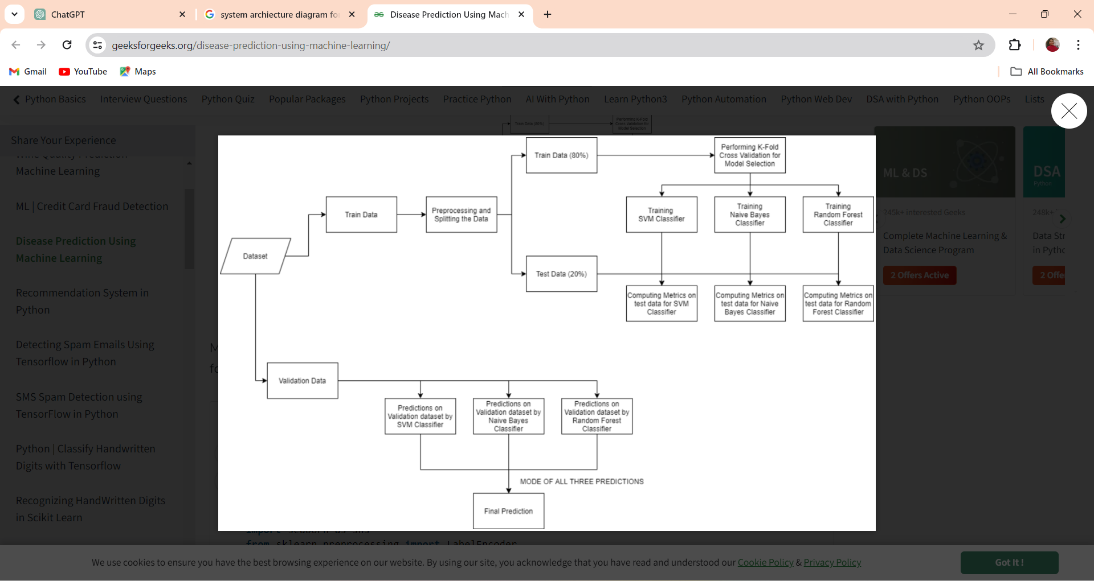
SYSTEM ARCHITECTURE :
The architecture of the "Disease Prediction Using Symptoms" system involves several interconnected components working together to enable symptom input, disease prediction, user management, data storage, and system operation.

Slide 13
ALGORITHMS USED :
Naive Bayes Algorithm
Decision Tree Learning Algorithm
Random Forest Algorithm

Slide 14
NAIVE BAYES ALGORITHM :
The Naïve Bayes classifier is a supervised machine learning algorithm, which is used for classification tasks, like text classification. It is also part of a family of generative learning algorithms, meaning that it seeks to model the distribution of inputs of a given class or category.
Naive Bayes is called naive because it assumes that each input variable is independent. This is a strong assumption and unrealistic for real data; however, the technique is very effective on a large range of complex problems.

Slide 15
DECISION TREE LEARNING ALGORITHM :
Decision tree learning algorithm constructs a tree-like structure to represent the relationship between input features and output classes.
Classification trees partition the input space into regions corresponding to different classes, while regression trees predict continuous output values.
Decision trees are intuitive and interpretable models that can be used for both classification and regression tasks, making them popular in data mining and decision-making scenarios.

Slide 16
RANDOM FOREST ALGORITHM ::
The Random Forest algorithm is an ensemble learning method that combines the power of multiple decision trees to improve classification accuracy.
It works by building a collection of decision trees, each trained on a random subset of the data and features.
The final prediction is made by aggregating the predictions of individual trees through voting or averaging.
Random Forests are known for their robustness, scalability, and ability to handle high-dimensional data with many input factors.

Slide 17
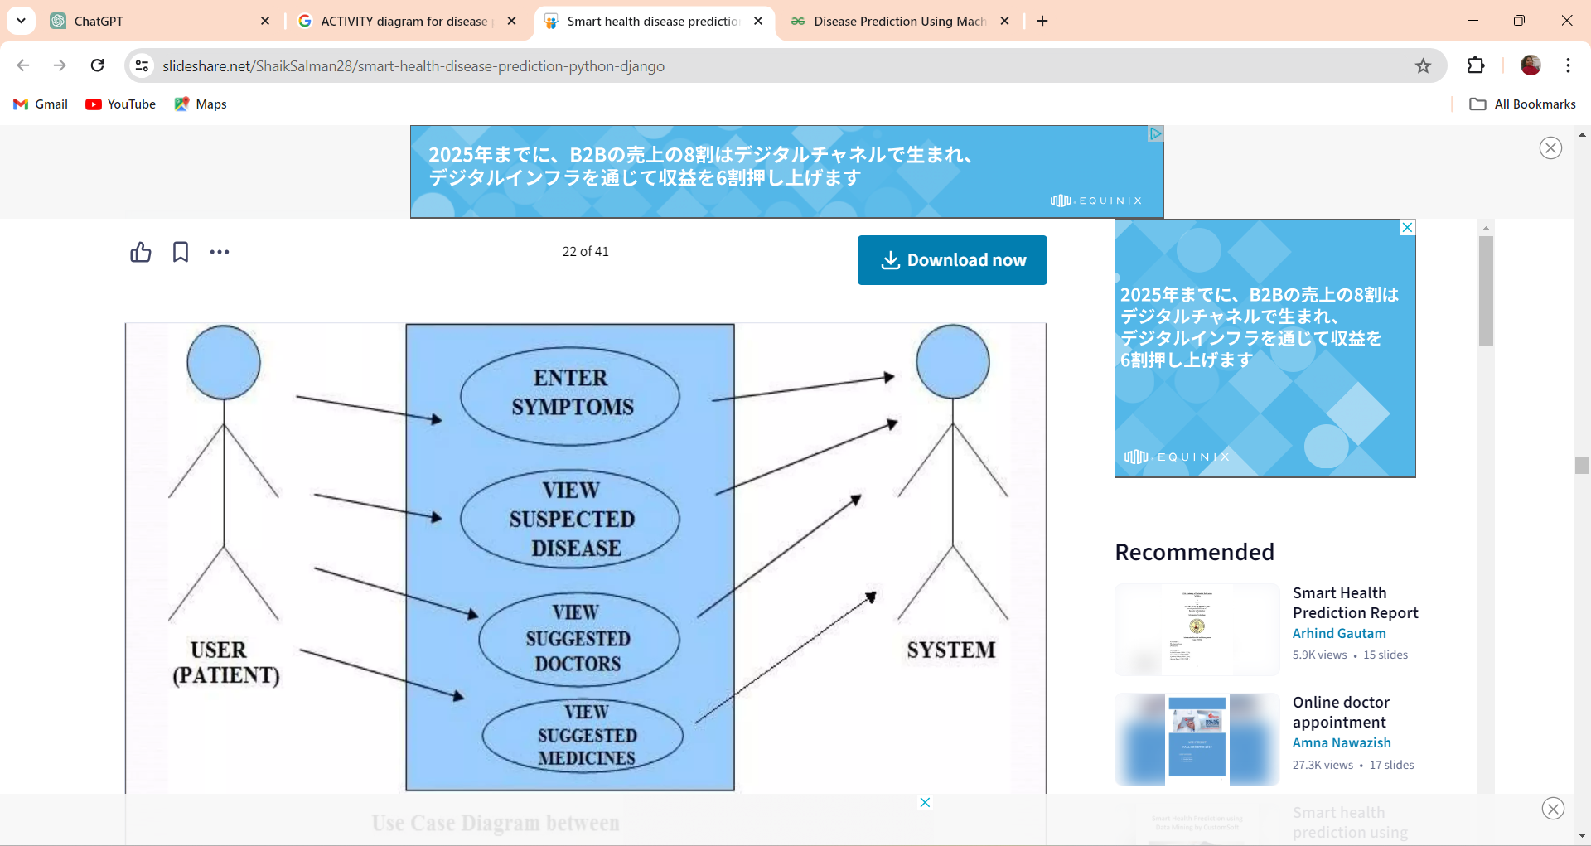
USE CASE DIAGRAM :

Slide 18
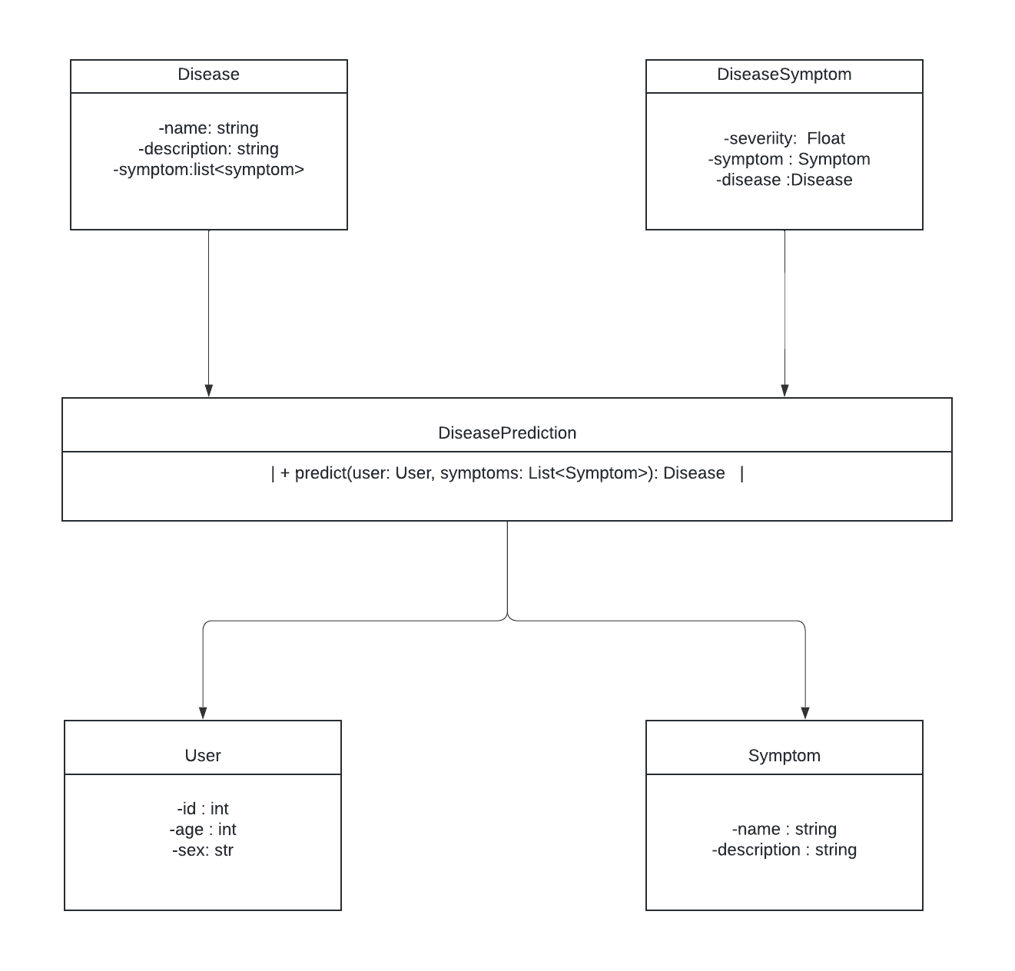
CLASS DIAGRAM :

Slide 19
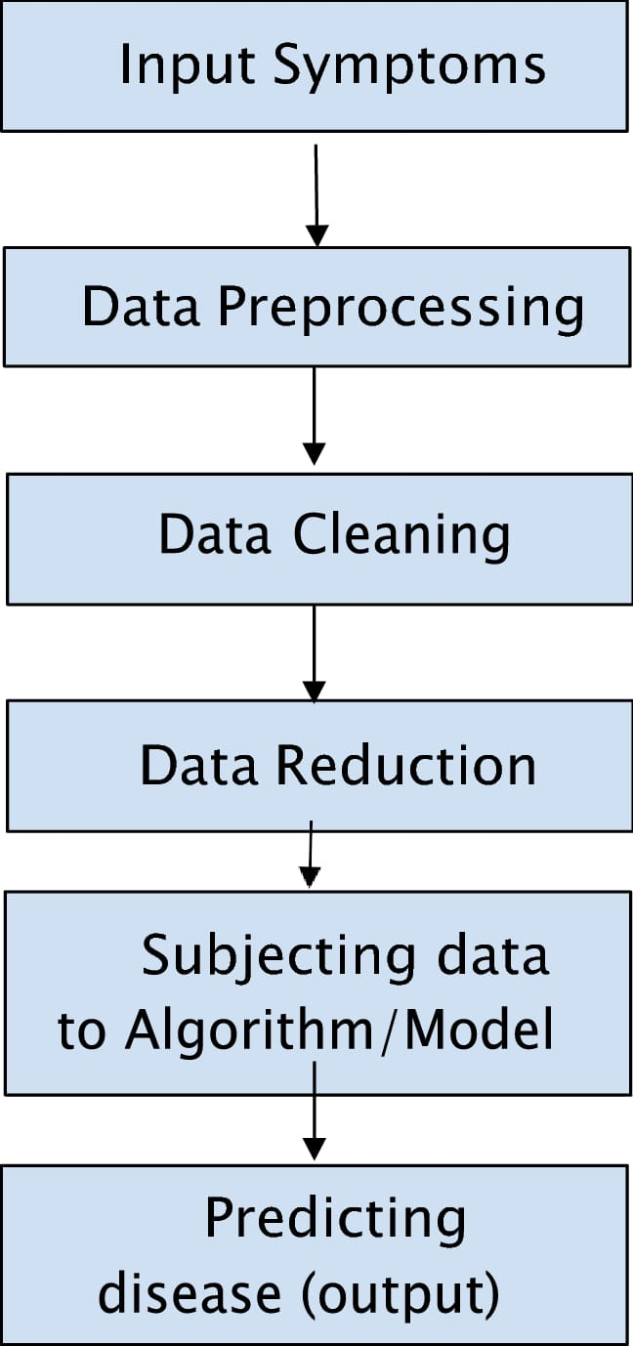
ACTIVITY DIAGRAM :

Slide 20
IMPLEMENTATION
Technologies used
Tools Used

Slide 21
Technologies used:
Python:
These are some facts about Python. Python is present most widely used multi_x0002_purpose and high-level programming language.it allows programming in Object_x0002_Oriented and Procedural paradigms. Python programs commonly are smaller than other programming languages like Java. Programmers have to write relatively less and indentation requirement of the language, makes them readable all the time. Python language is being used by the almost all tech-giant companies like –
Google, Amazon, Facebook, Instagram, Dropbox, Uber… etc. The biggest
strength of Python language is huge collection of standard library

Slide 22
Tools used:
VISUAL STUDIO CODE (VS CODE)
Visual Studio Code (VS Code) is a popular source-code editor developed by Microsoft
for Windows, Linux, and macOS. It provides developers with a highly customizable and
feature-rich environment for writing, debugging, and managing code across a variety of
programming languages. VS Code offers built-in support for syntax highlighting, code
completion, debugging, version control integration (such as Git), and an extensive
ecosystem of extensions that further enhance its functionality for various development
workflows. It's known for its performance, versatility, and active community support.

Slide 23
INPUT DATA :
By using Django, we integrate our machine learning model with front-end. It takes the following input :
Dataset to build the model.
Input software to predict the output.
DATASET :
In order to predict the output, we collected data from kaggle that is previously predicted symptoms dataset.

Slide 24
TESTING
The purpose of testing is to discover errors. Testing is the process of trying to discover every conceivable fault or weakness in a work product. It provides a way to check the functionality of components, sub-assemblies, assemblies and/or a finished product It is the process of exercising software with the intent of ensuring that the Software system meets its requirements and user expectations and does not fail in an unacceptable manner.
TYPES OF TESTING:
Unit testing
Integrated Testing
Functional Testing
White Box Testing
Black Box Testing
Acceptance Testing

Slide 25
TEST CASES :
S.NO | TEST CASE | EXPECTED RESULT | ACTUAL RESULT | STATUS
1 | If user gives Input Dataset File | Input is accepted | Input is accepted | Pass
2 | Build the Model for calculating the accuracy for algorithms | Input is accepted | Input is accepted | Pass
3 | Calculate the aveage accuracy of the model on all datsets seperately | Input is accepted | Input is accepted | Pass
4 | If user gives trained and corrected Example file | Input is accepted | Input is accepted | Pass
5 | If user gives non trained and uncorrected Example file | Input is accepted | Displays as errors | Pass

Slide 26
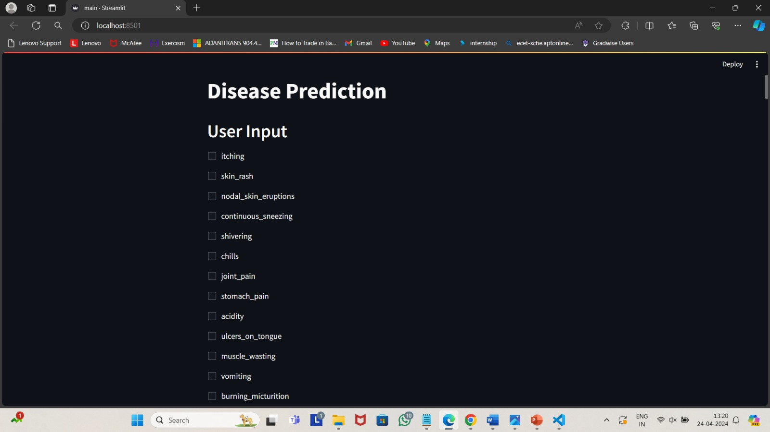
OUTPUT SCREENS :

Slide 27
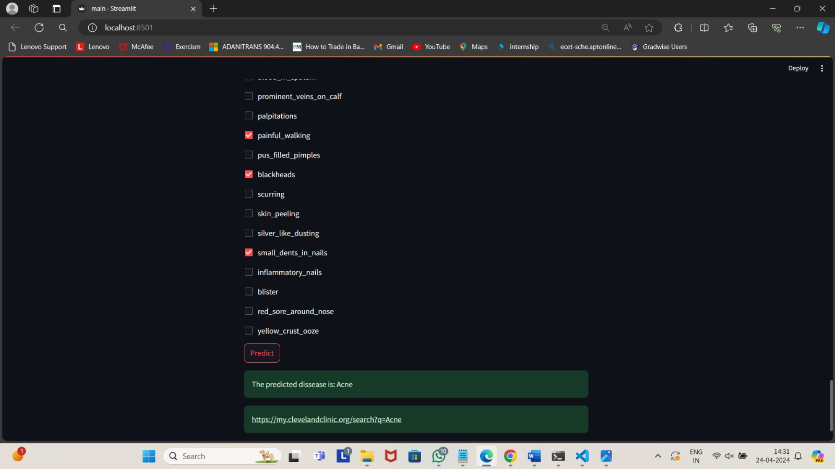

Slide 28
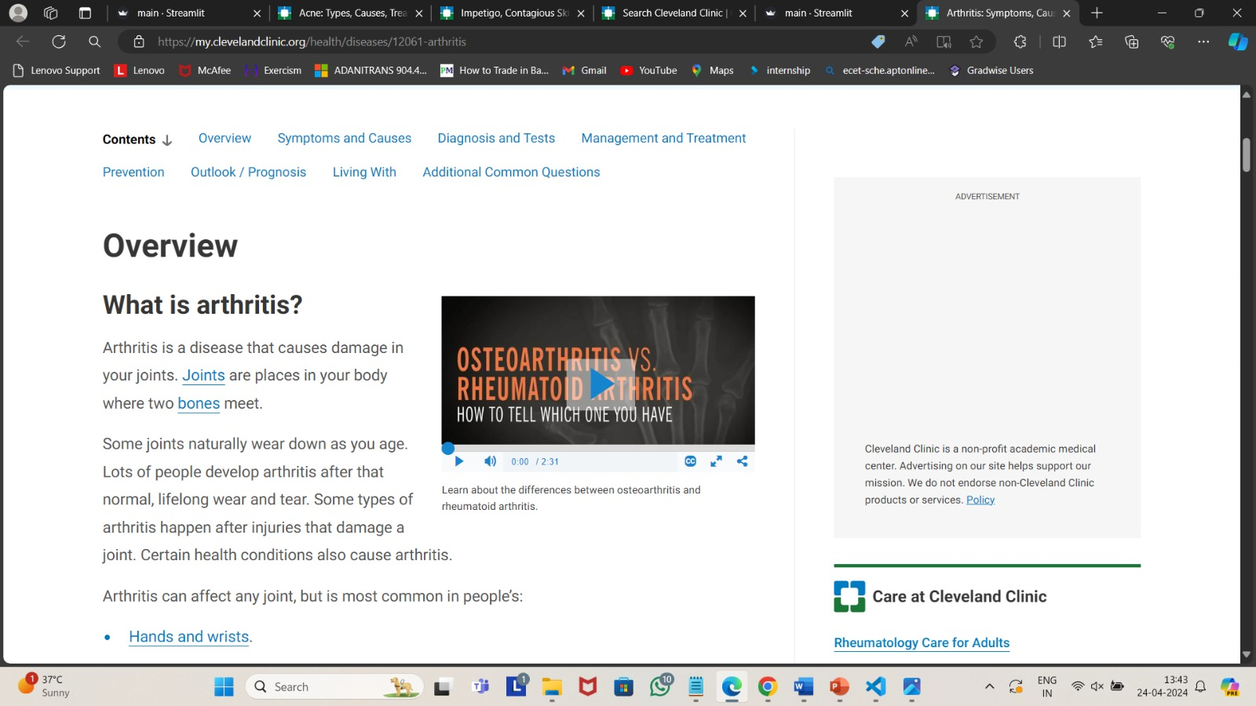

Slide 29
FUTURE ENHANCEMENT :
Potential enhancements may include the integration of additional data sources, such as genetic information or lifestyle factors, to enhance the accuracy and specificity of disease predictions.
The incorporation of advanced machine learning techniques, such as deep learning or ensemble learning, could potentially improve prediction performance and enable the system to handle a wider range of diseases and health conditions.
Moreover, the inclusion of features for personalized health recommendations or treatment suggestions based on predicted diseases could further empower users to take proactive steps towards managing their health.

Slide 30
CONCLUSION :
The significance of the project on disease prediction using machine learning cannot be overstated, particularly within the healthcare sector where such systems are indispensable tools for forecasting patients' illnesses based on their symptoms and general characteristics.
In conclusion, the disease prediction system using symptoms in Python has shown promising results in accurately identifying potential illnesses.
By leveraging machine learning algorithms and comprehensive symptom data, this system offers a valuable tool for early detection and personalized healthcare.

Slide 31
REFERENCES :
[1]. M. Jiang, Y. Chen, M. Liu, S. T. Rosenbloom, S. Mani, J. C. Denny, and H. Xu, “A study of machine-learning-based approaches to extract clinical entities and their assertions from discharge summaries,”J. Am Med Inform Assoc, vol. 18, no. 5, pp. 601–606, 2011.
[2]. M. Chen, Y. Hao, K. Hwang, L. Wang, and L. Wang,“Disease prediction by machine learning over big data from healthcare communities” IEEE Access, vol. 5, no.1, pp.8869–8879, 2017.
[3]. Sayali Ambekar, Rashmi Phalnikar, “Disease RiskPrediction by Using Convolutional Neural Network” IEEE, 978-1-5386-5257-2/18, 2018.
[4]. Naganna Chetty, Kunwar Singh Vaisla and Nagamma Patil, “An Improved Method for Disease Predictionusing Fuzzy Approach” IEEE, DOI 10.1109/ICACCE.2015.67, pp. 569-572, 2015.

Slide 32
THANK YOU!

